Slide 1



Project Report on: Customer Retention

Slide 2
Content
Overview.
What is customer Retention?
Need of customer retention.
Problem Statement.
Problem Understanding.
Exploratory data analysis.
Data cleaning.
Visualization.
Analysis
Conclusion.

Slide 3
1.Overview
In this presentation we’ll look into the following:
What are the different factor affecting customer retention.
What are the criterion to retain customers.
Overall analysis of the problem.
How can we improve customer retention.

Slide 4

2. What is Customer Retention?
Customer retention refers to the activities and actions companies and organizations take to reduce the number of customer defections. The goal of customer retention programs is to help companies retain as many customers as possible, often through customer loyalty and brand loyalty initiatives. It is important to remember that customer retention begins with the first contact a customer has with a company and continues throughout the entire lifetime of the relationship.

Slide 5
3. Need of customer Retention
Less spending on customer acquisition : Acquiring a new customer can be up to five times more expensive than retaining an existing one.
Increased profits : An increase in client retention by 5% can enhance profits by over 25% .
Improved online reputation : Over 37% of customers will only post online reviews if they are “extremely satisfied”.
Positive Reviews : The longer customers stay with a company, the more business, positive reviews, and they bring word of mouth advertising.

Slide 6
4. Problem Statement
Customer satisfaction has emerged as one of the most important factors that guarantee the success of online store; it has been posited as a key stimulant of purchase, repurchase intentions and customer loyalty. A comprehensive review of the literature, theories and models have been carried out to propose the models for customer activation and customer retention. Five major factors that contributed to the success of an e-commerce store have been identified as: service quality, system quality, information quality, trust and net benefit. The research furthermore investigated the factors that influence the online customers repeat purchase intention. The combination of both utilitarian value and hedonistic values are needed to affect the repeat purchase intention (loyalty) positively.

Slide 7
5. Problem understanding
Customer retention means the process of maintaining or keeping customers once you have acquired them. It’s all the activities that a company must do in order to keep their customers around. The goal is to build a long-lasting relationship between the brand and consumers. Once a customer becomes loyal to your brand, not only he will buy more from you than a normal customer but he’ll spread good words about your business, increase your reputation. Here we have to analyse the affect of different feature on customer retention.

Slide 8
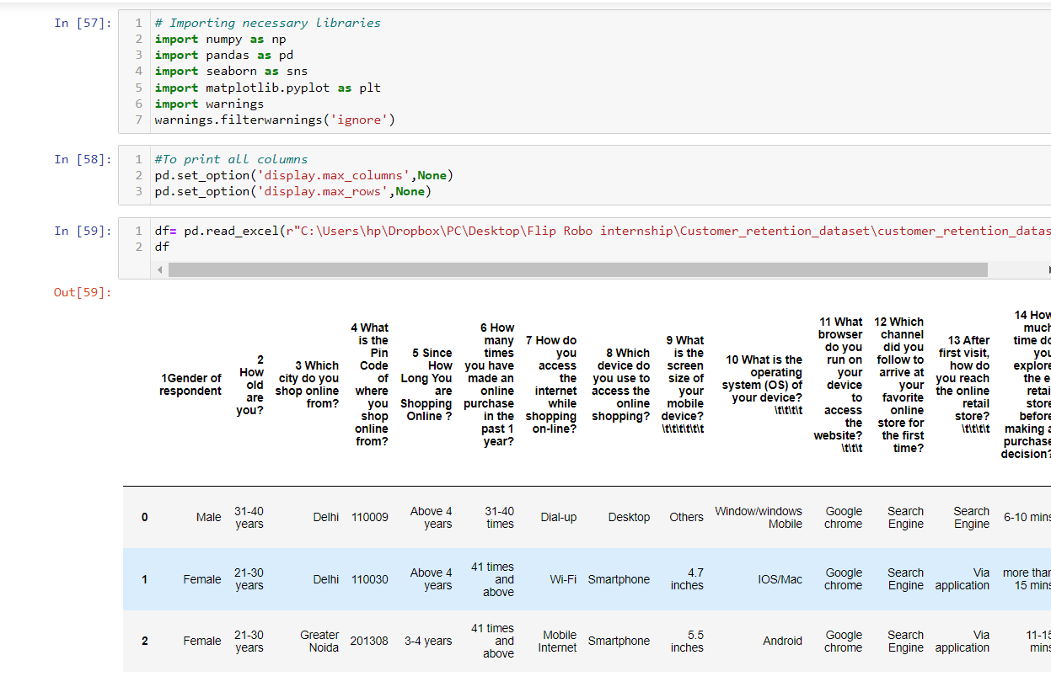
6. Exploratory Data Analysis
First I imported the important libraries we require to analyse this problem.
Then I imported the Dataset which was in excel format using pandas (one of the library that we imported).

Slide 9
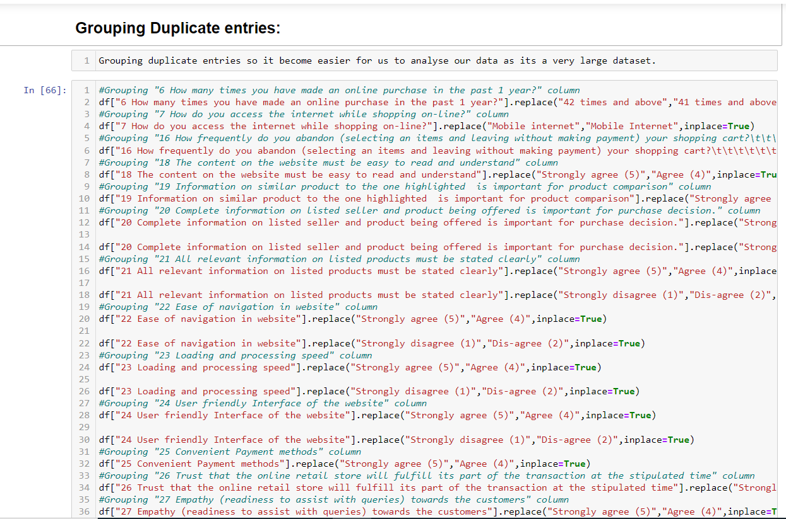
6 . Exploratory Data Analysis
After importing dataset I did some analysis like checking the shape of dataset,checking for null value presesnce,checking unique value each feature contains and it’s value counts.
Then while looking into the value counts I found some duplicate entries in the features i.e., two words with same meaning. I have replaced those duplicates by grouping them.

Slide 10
7. Data Cleaning
1) The data type of pincode column was integer type but pincode is a code which will be given to perticular location and it will be unique so the datatype should object. So I have changed the datatype of Pincode column if I won’t have changed the datatype it would have carried some wrong information and effected our analysis.
This is how I converted the data type of pincode:
[df['4 What is the Pin Code of where you shop online from?'] = df['4 What is the Pin Code of where you shop online from?'].astype("object")]
2) And the column titles are very descriptive and they look hard to handle and takes extra time to understand and analyse ,so I have changed my column titles into there shorter and easy to understand version which will help us in further analysis.

Slide 11
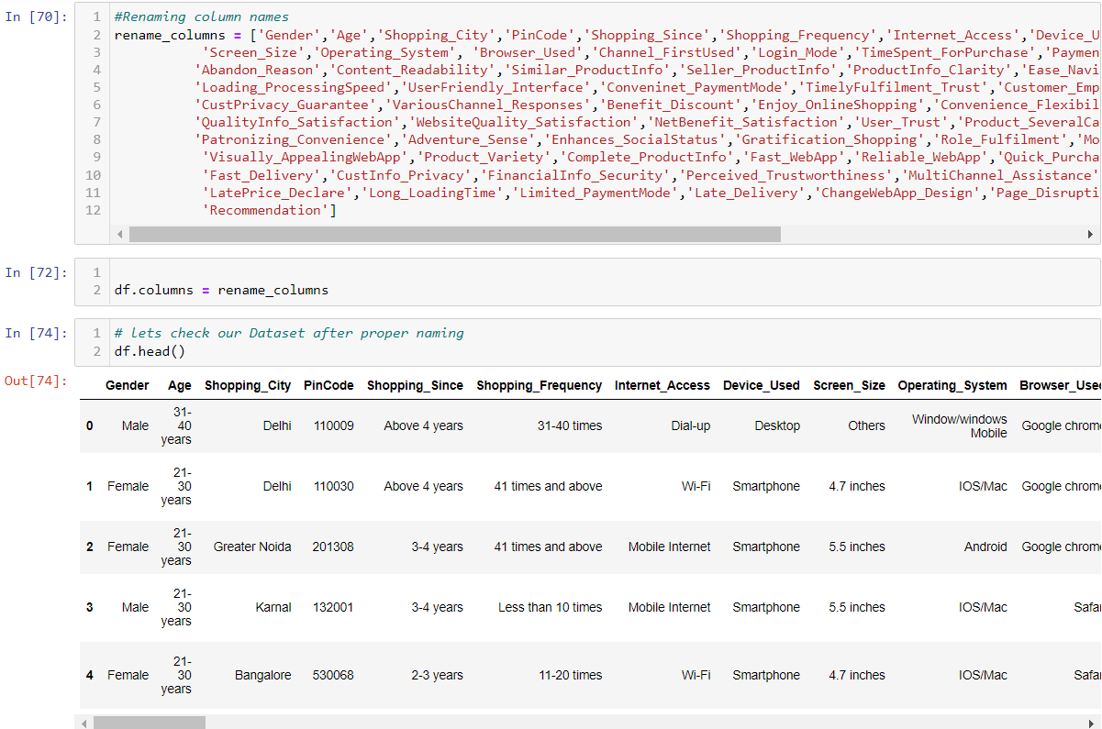
7. Data Cleaning

Slide 12
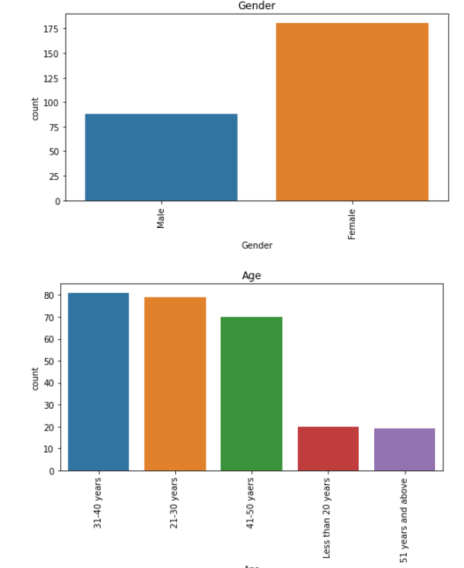
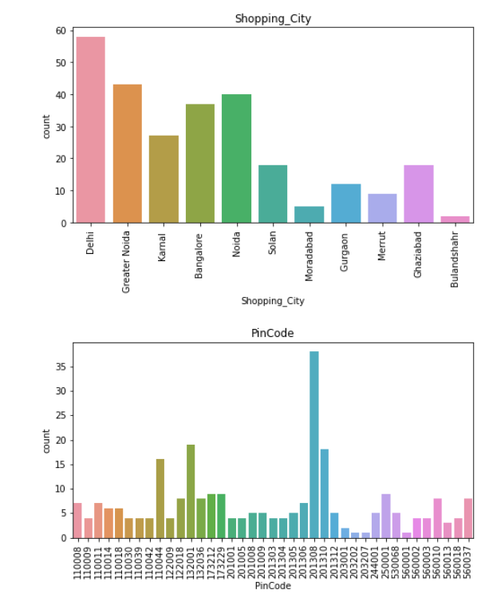
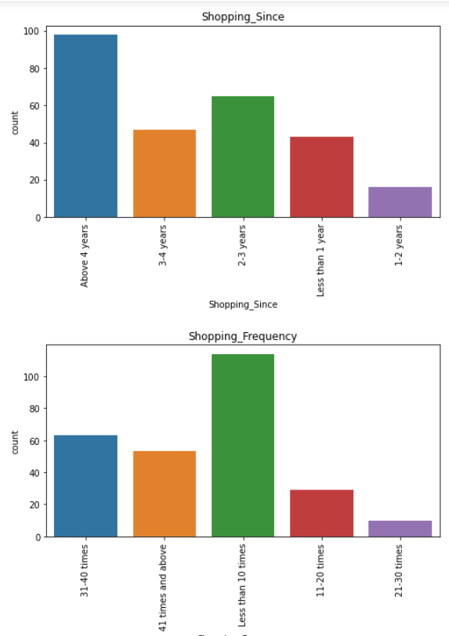
8.Visualization(Using sns.countplot)

Slide 13
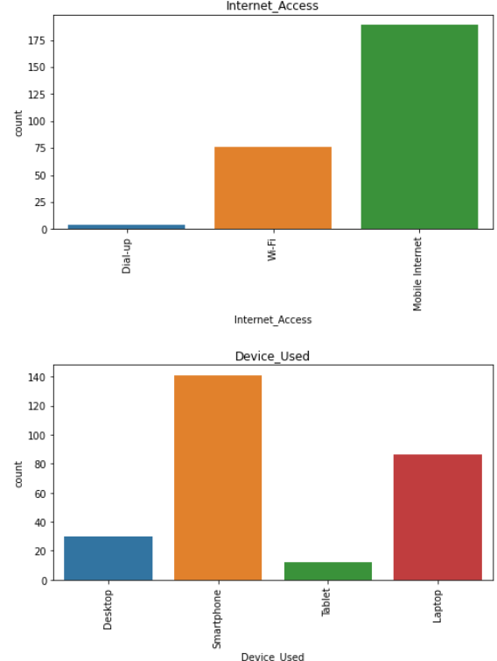
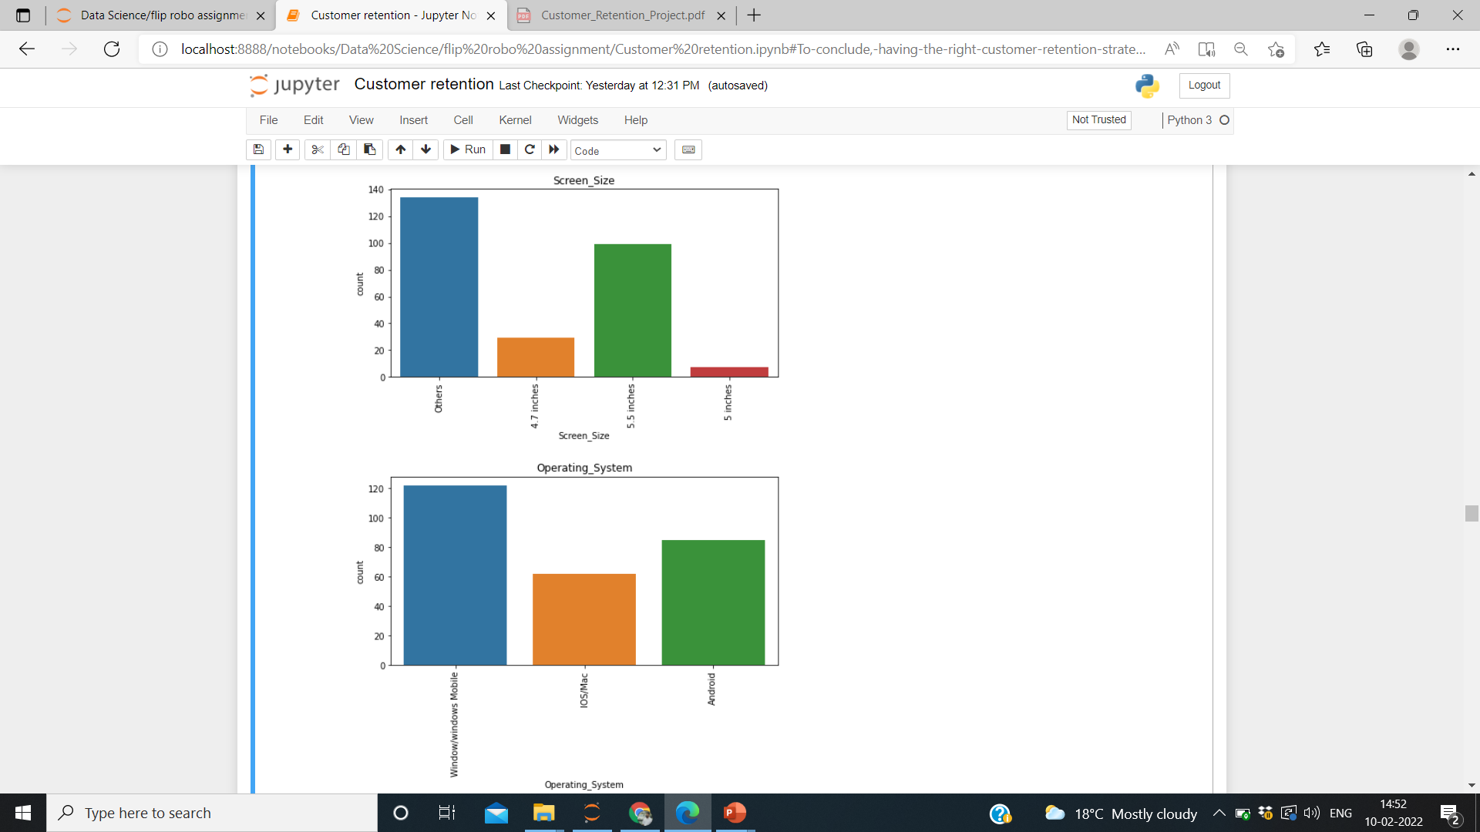
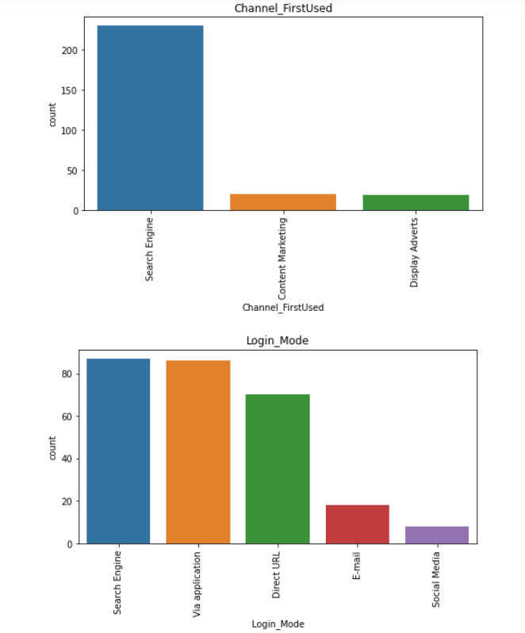
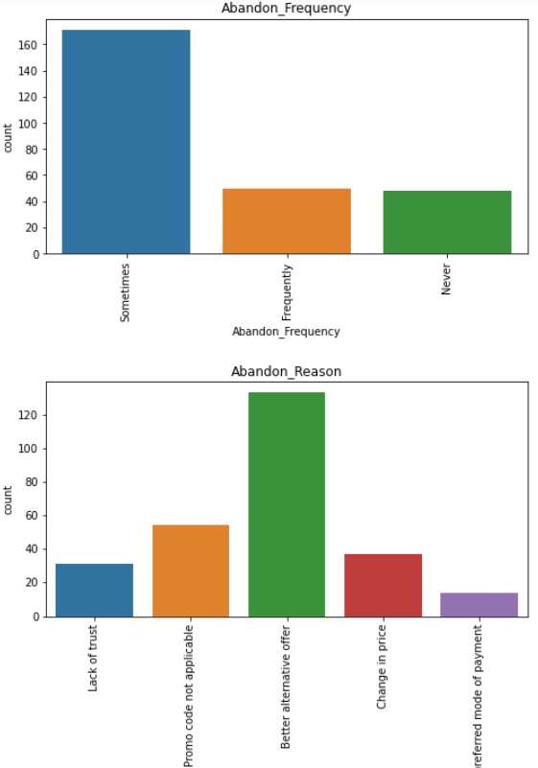
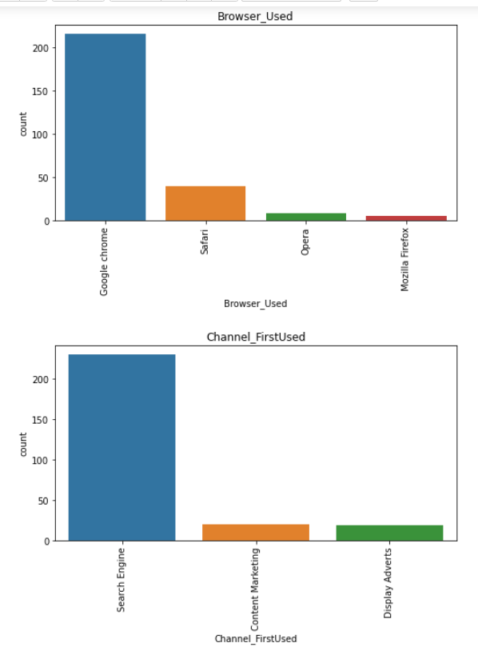

Slide 14
Observations
Similarly I have ploted countplots for every single features and ther are the observation that I made out of it:
Female customer often prefer to purchase more as compared to Male customer
People between 21 to 50 years of age tends shops more.
Delhi has maximum count which means in Delhi the online purchase is high.
A city with pin code 201308 has maximum online shopping, which means in this area people oftenly buy/purchase producs online.
The count is high for Above 4 years which means people are choosing to shop online since 4 years.
The count is high for less than 10 times.People who are shopping less than 10 times (usually during any festival or may be some special occation) per year are more in number.
Most of the customer uses there mobile internet to shop online, which seems to be more convinient to use.
Maximum customers uses smartphones while shopping,which is easy to operate.

Slide 15
Mobile screen size has maximum count for others,and 2nd most count is for 5.5 which is the most used screen size.
Customers with OS windows/windows mobile are more in number,as it's the most common OS.
Most of the customers uses chrome browser,which seems to be best in market and easy to use.
Most of the customers used Search engine to reach there favorite online store for the first time , as search engine shows variety of similar product from n-number of sites.
After first visit most of the customers are reaching the online store through Search engine, Via application and Direct Url.
Most of the customers are exploring the e-retail store more than 6 mins before making purchase decision (checking all info and deciding which one to buy usually take time).
Maximum customers are using credit/debit cards for there payment(most convinient and easy to use).
The count of abandon is high for sometimes, which means people who are abandoning sometimes are more.
Most of the customers are abandoning because to get better alternative offers , which seems to be obvious usually we prefer good product at cheaper price.
Most of the customers are agreeing that the content should be easy to understand on the website.
Most of the customers are agreeing that the Information on similar prodct to the one highlighted is important for product comparison.
Most of the customers are agreeing that the Complete information on listed seller and product being offered is important for purchase decision.
Most of the customers agrees that the relevant information on listed products must be stated clearly(as there should be no room for any kind of error or misunderstanding).
Maximum customers are agreeing that it should be easy to navigate in websites.
Maximum customers are agreeing that loading and processing speed should be high.

Slide 16
Maximum customers agrees to have user friendly interface of the website.
Maximum customers agrees to have convenient payment methods.
Maximum customers Trust that the online retail store will fulfill its part of the transaction at the stipulated time.
Maximum customers agrees to have Empathy (readiness to assist with queries) towards the customers.
Maximum customers agrees to have the ability to guarantee the privacy of the customer.
Maximum customers agrees to have Responsiveness, availability of several communication channels (email, online rep, twitter, phone etc.).
Maximum customers agrees to have Online shopping gives monetary benefit and discounts.
Maximum customers agrees to have Enjoyment is derived from shopping online.
Maximum customers agrees to have Shopping online is convenient and flexible.
Maximum customers agrees that Return and replacement policy of the e-tailer is important for purchase decision.
Maximum customers agrees that Gaining access to loyalty programs is a benefit of shopping online.
Maximum customers agrees that Displaying quality Information on the website improves satisfaction of customers.
Maximum customers agrees that User derive satisfaction while shopping on a good quality website or application.
Maximum customers agrees that Net Benefit derived from shopping online can lead to users satisfaction.
Maximum customers agrees that User satisfaction cannot exist without trust.
Maximum customers agrees to have Offering a wide variety of listed product in several category.
Maximum customers agrees to have Provision of complete and relevant product information.

Slide 17
Maximum customers agrees to have Monetary savings.
Maximum customers agrees to have the Convenience of patronizing the online retailer.
Maximum customers agrees that Shopping on the website gives you the sense of adventure.
Maximum customers agrees that Shopping on your preferred e-tailer enhances your social status.
Maximum customers agrees that You feel gratification shopping on your favorite e-tailer.
Maximum customers agrees that Shopping on the website helps you fulfill certain roles.
Maximum customers agrees to Getting value for money spent.
From column 47 onward column contain info about e-retail sites and observation from that is :
Amazon and flipkart is performing best in all given parameter
And are mostly recommended by customer
These 2 have more advantage over disadvantage
After Countplot I analyse data using factor plot, which we will be seeing in our next slide:

Slide 18
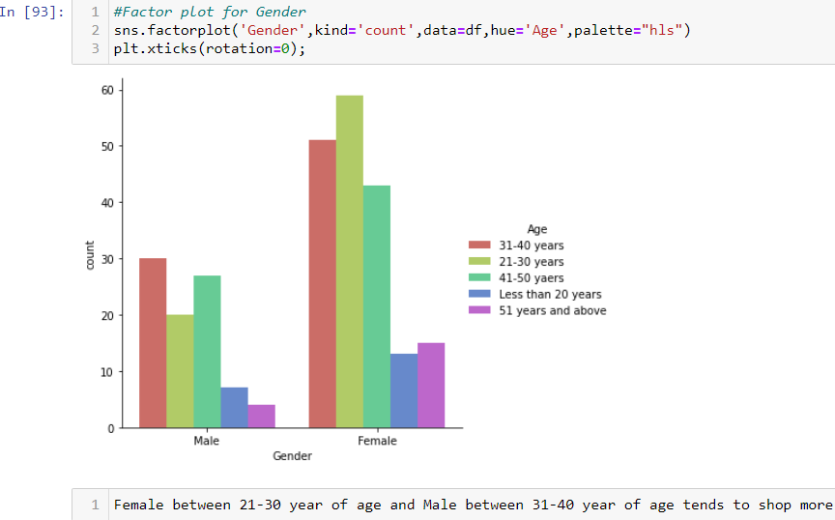
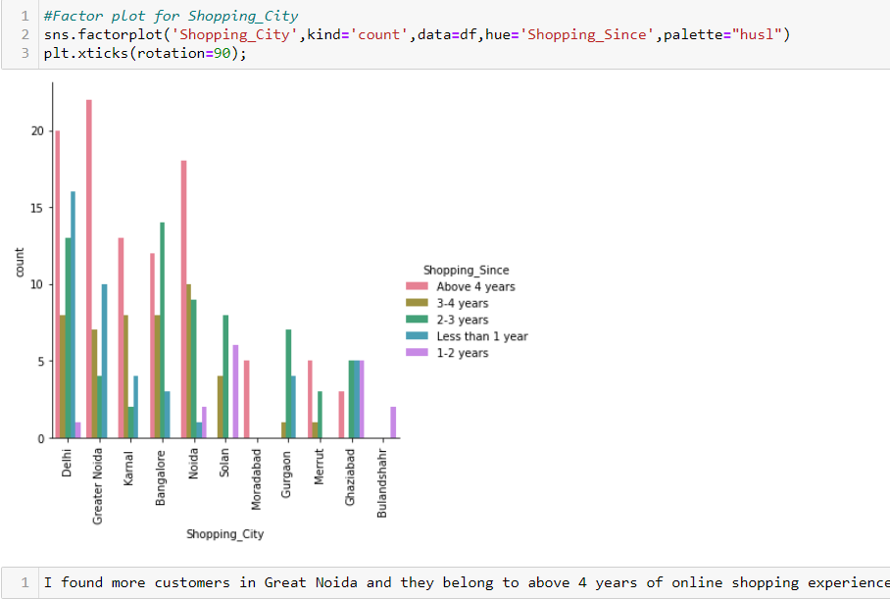
8 .Visualization(Factorplot )
Some of the plots are shown below

Slide 19
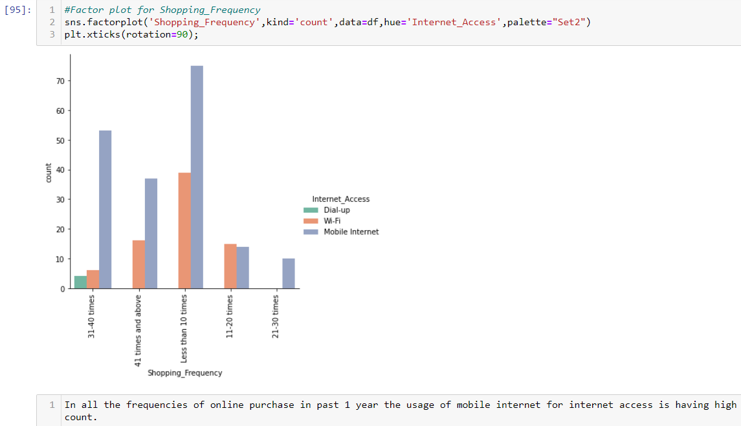
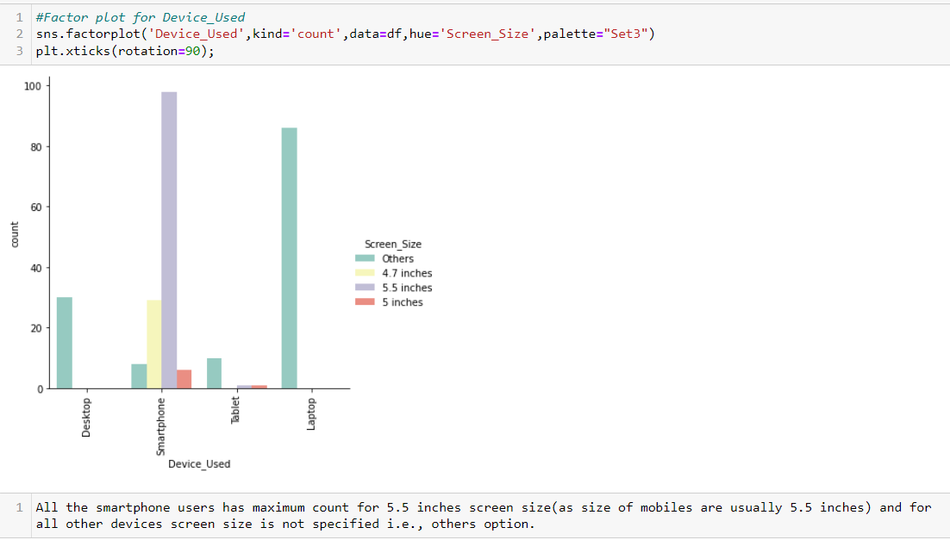
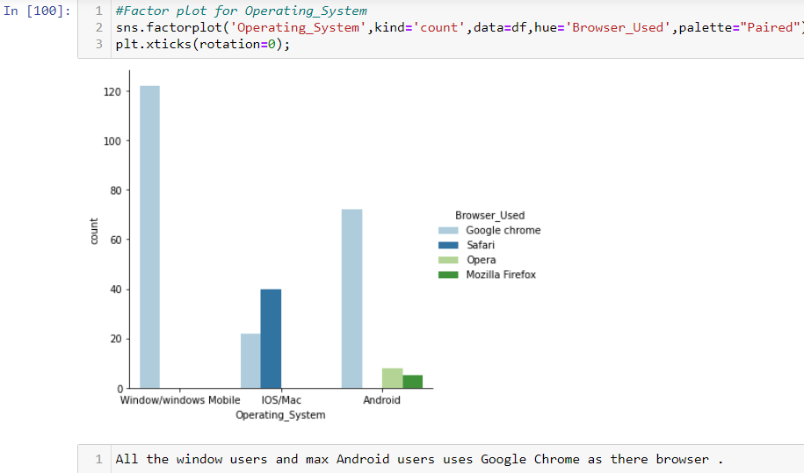
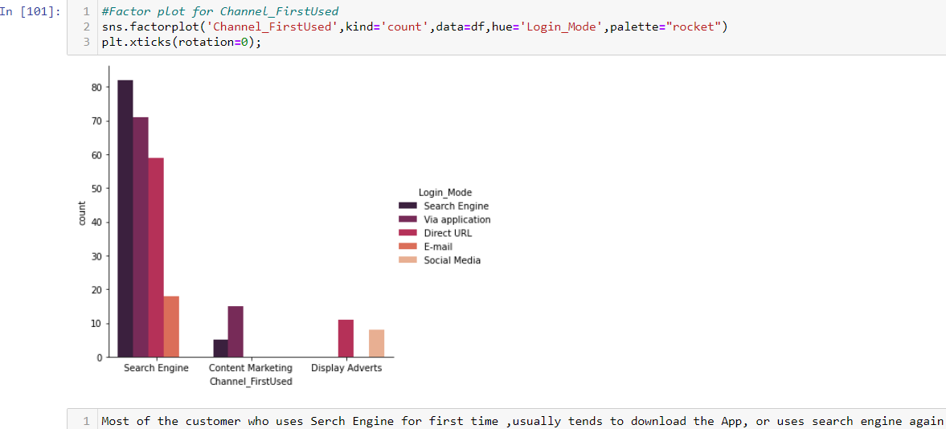

Slide 20
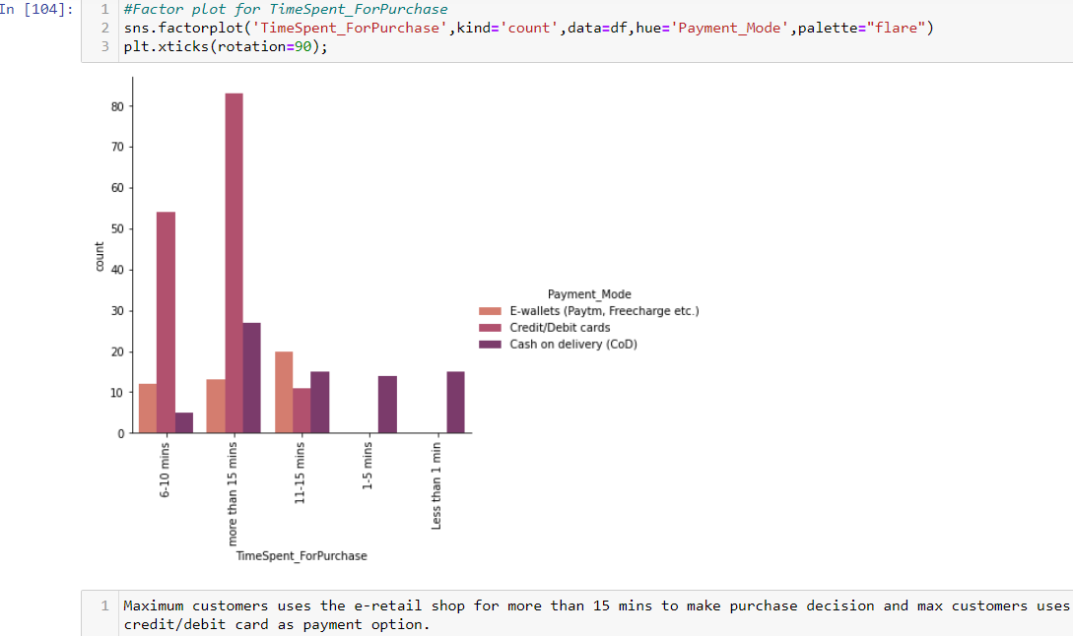
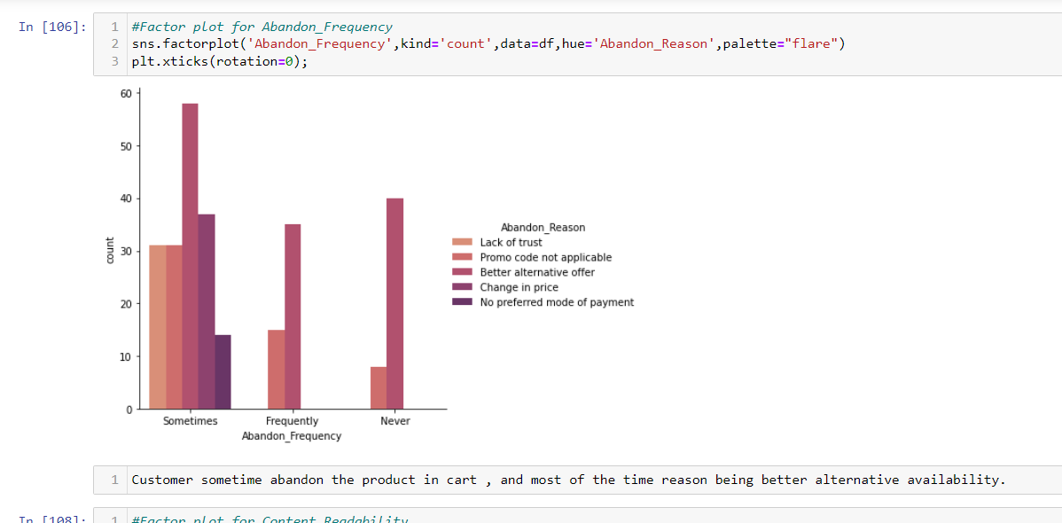
Visualization(Feature having any kind of relation)
Here I have ploted some graph between the feature which have any kind of relationship between them. After analysing them I observe some important factor responsible for customer retention.

Slide 21
9. Anaylasis
Most of the customers are females with age from 20-50 and they used mobile internet to access with Windows as operating system.
And most of the customers used search engines to get into the platform first time and frequently.
Max customers uses there debit/credit cards for there payment.
Almost customers has a expectation to have Content_Readability, Similar_ProductInfo, Seller_ProductInfo, ProductInfo_Clarity, Ease_Navigation, Loading_ProcessingSpeed, UserFriendly_Interface, Conveninet_PaymentMode, TimelyFulfilment_Trust, Customer_Empathy, CustPrivacy_Guarantee, VariousChannel_Responses, Benefit_Discount, Enjoy_OnlineShopping, Convenience_Flexibility, Returns_ReplacementPolicy, Loyalty_ProgramAccess, QualityInfo_Satisfaction, WebsiteQuality_Satisfaction, NetBenefit_Satisfaction, User_Trust, Product_SeveralCategory, Relevant_ProductInfo, Monetary_Savings, Patronizing_Convenience, Adventure_Sense, Enhances_SocialStatus, Gratification_Shopping, Role_Fulfilment, Money_Worthy in e-commerce websites.

Slide 22
Compared to other platforms shopping with Amazon.in and Flipkart.com has maximum benefits rather than drawbacks.
Compared to all other online shopping platforms Snapdeal and Myntra has maximum drawbacks.
And having maximum good feedbacks Amazon is recommended by most of the customers.

Slide 23
10. Conclusion
While going through the problem and in detailed analysis I found the following conclusions:
Frequency of Females shoping is high so making them satisfied will help the sellers to get more business.
Loyal customers prefer buying and tend to spend more money on shopping in your store. Statistics show that engaged consumers purchase more frequently. It is necessary to hear customer feedback because most of them are valuable feedbacks.
Sometimes customer feedback is the best marketing strategy. They are frequent customers so they will know which areas of your business may well be improved. If their feedback is approved, they will extremely excite and support your company with their best ability.
Here as an conclusion part I found that using dead old strategies for retailers will effect customer retention.
Organisation will always focus on success for that keeping the old customers will always be a plus point.
Also Paytm and Snapdeal has maximum drawbacks it is because of their dead old strategies.

Slide 24
I found Amazon and Flipkart are standing best out in the market by using ethical, reasonable business strategies.
When customers are satisfied with a company or service, there is a high possibility that they will share their experience with other people Therefore it is crucial for E-commerce to take into account their customer satisfaction because this will retain customer loyalty as well as attract potential customers.
Having the right customer retention strategy will keep sellers company growing if they know how to take advantage of it. Then customers will find their way back and continue buying stuff from the best company

Slide 25

Thank you
Presented by:
Vishal Lakhera
Batch no:
1836

